Slide 1
שפת PROC שפת "וישגור" שפה עם פרוצדורות
EOPL3: Section 3.3 PROC and App B: SLLGEN

Slide 2
The PROC language
Expression ::= proc (Identifier) Expression
AST: proc-exp (var body)
Expression ::= (Expression Expression)
AST: call-exp (rator rand)
PROC includes all of LET language
Anonymous procedure
One parameter always

Slide 3
Semantics of Procedures
(This slide is for procedures in general.)
Procedure Definition
Store formal parameters and body
Procedure Invocation
Evaluate body in an environment that binds formals to actual argument values
Interpretation of free-variables: Two methods
Use env at proc definition (lexical/static scoping)
Use env at proc call (dynamic scoping)

Slide 4
Example-1 of PROC
let f = proc (x) -(x,11) in (f (f 77))
Defines an anonymous procedure with one formal parameter named x.
Body of the procedure: -(x,11)
Binds the name f to this procedure.
Invokes f with actual argument 77.
Invokes f again with the result of above.

Slide 5
Example-2 of PROC
(proc (f) (f (f 77)) proc (x) -(x,11))
This example is derived from the production
Expression ::= (Expression Expression)
so is (f (f 77))
so is (f 77)
proc (f) (f (f 77)) is the rator.
It defines an anonymous procedure with one formal parameter named f.
proc (x) -(x,11)) is the rand.
It also defines an anonymous procedure with one formal parameter named x.

Slide 6
Example-3 of PROC
let x = 200 in let f = proc (z) -(z, x) in let x = 100 in let g = proc (z) -(z, x) in -((f 1), (g 1))
Illustrates scope issues
x and z appear four times each.
Lexical scoping
In -((f 1), (g 1)), the bodies of f and g must be evaluated in the env they were defined.
In f, x is bound to 200
In g, x is bound to 100

Slide 7
Example Programs of PROC
Example-1 and -2 produce same result, but different mechanisms.

Slide 8
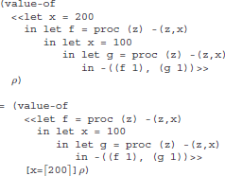
Example Calc w/ Spec 1

Slide 9
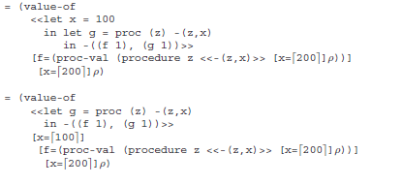
Example Calc w/ Spec 2

Slide 10
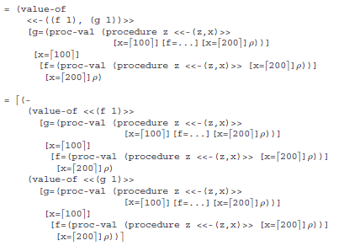
Example Calc w/ Spec 3

Slide 11
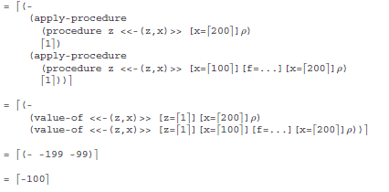
Example Calc w/ Spec 4

Slide 12
Recall value-of
value-of is an operator with two operands
an AST
an environment
(value-of ast env)
PROC = LET + two more productions
Bring in all value-of specs from LET
Additions are shown on next few slides …

Slide 13
additional value-of specs
(value-of (proc-exp var body) ρ)
= (proc-val (procedure var body ρ))
(value-of (call-exp rator rand) ρ)
= (let ( (proc (expval->proc (value-of rator ρ)))
(arg (value-of rand ρ)))
(apply-procedure proc arg))
To be defined: proc-val, apply-procedure

Slide 14
Spec of apply-procedure
(apply-procedure (procedure var body ρ) val) = (value-of body [var=val]ρ )
apply-procedure takes two arguments:
an AST of a procedure definition
an argument for the parameter of the procedure
yields an expressed value

Slide 15
the data type expval is now …
(define-datatype expval expval?
(num-val
(num number?))
(bool-val
(bool boolean?))
(proc-val
(proc proc?)))

Slide 16
הסבר והדגמה של הקבצים הרלוונטיים לשפת "וישגור" בסביבת העבודה.

Slide 17
value-of: two new clauses
(proc-exp (var body)
(proc-val (procedure var body env)))
(call-exp (rator rand)
(let ( (proc (expval->proc (value-of rator env)))
(arg (value-of rand env)))
(apply-procedure proc arg)))

Slide 18
Curried procedures
In PROC, procedures with multiple arguments can be had as in:
let f = proc (x) proc (y) ... in ((f 3) 4)
proc (x) … yields a procedure
Named after Haskell Brooks Curry (1900 – 1982), a combinatory logician.

